Slide 1

Several Graphs - Complex Case

Slide 2

Reference
Chapter 9 (O'Reilly) of Hands-On ML
Youtube
Code

Slide 3
Warm Up

Slide 4
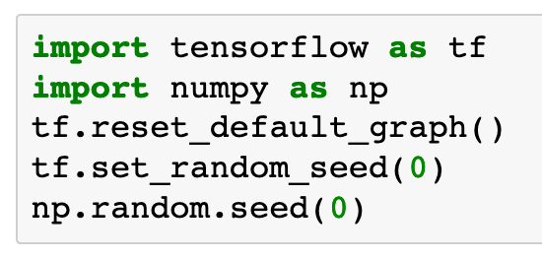

Slide 5
Several Graphs

Slide 6
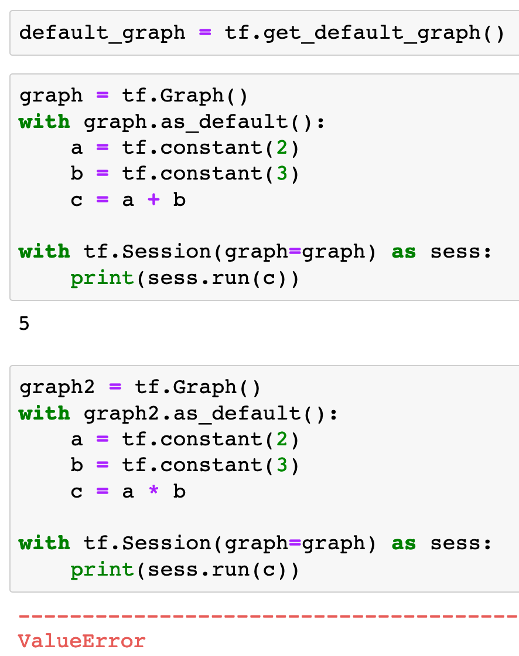


Slide 11
c.graph

Slide 12
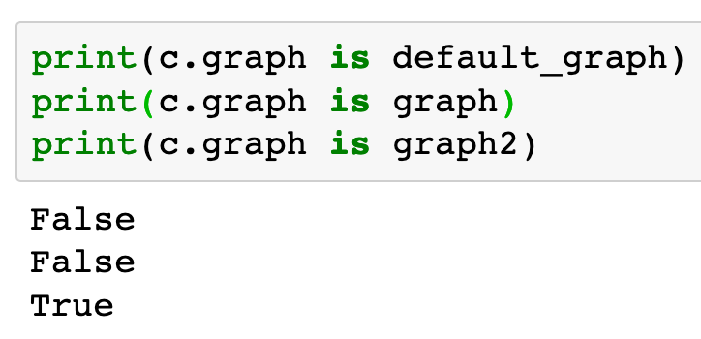

Slide 13
graph.get_operation()

Slide 14
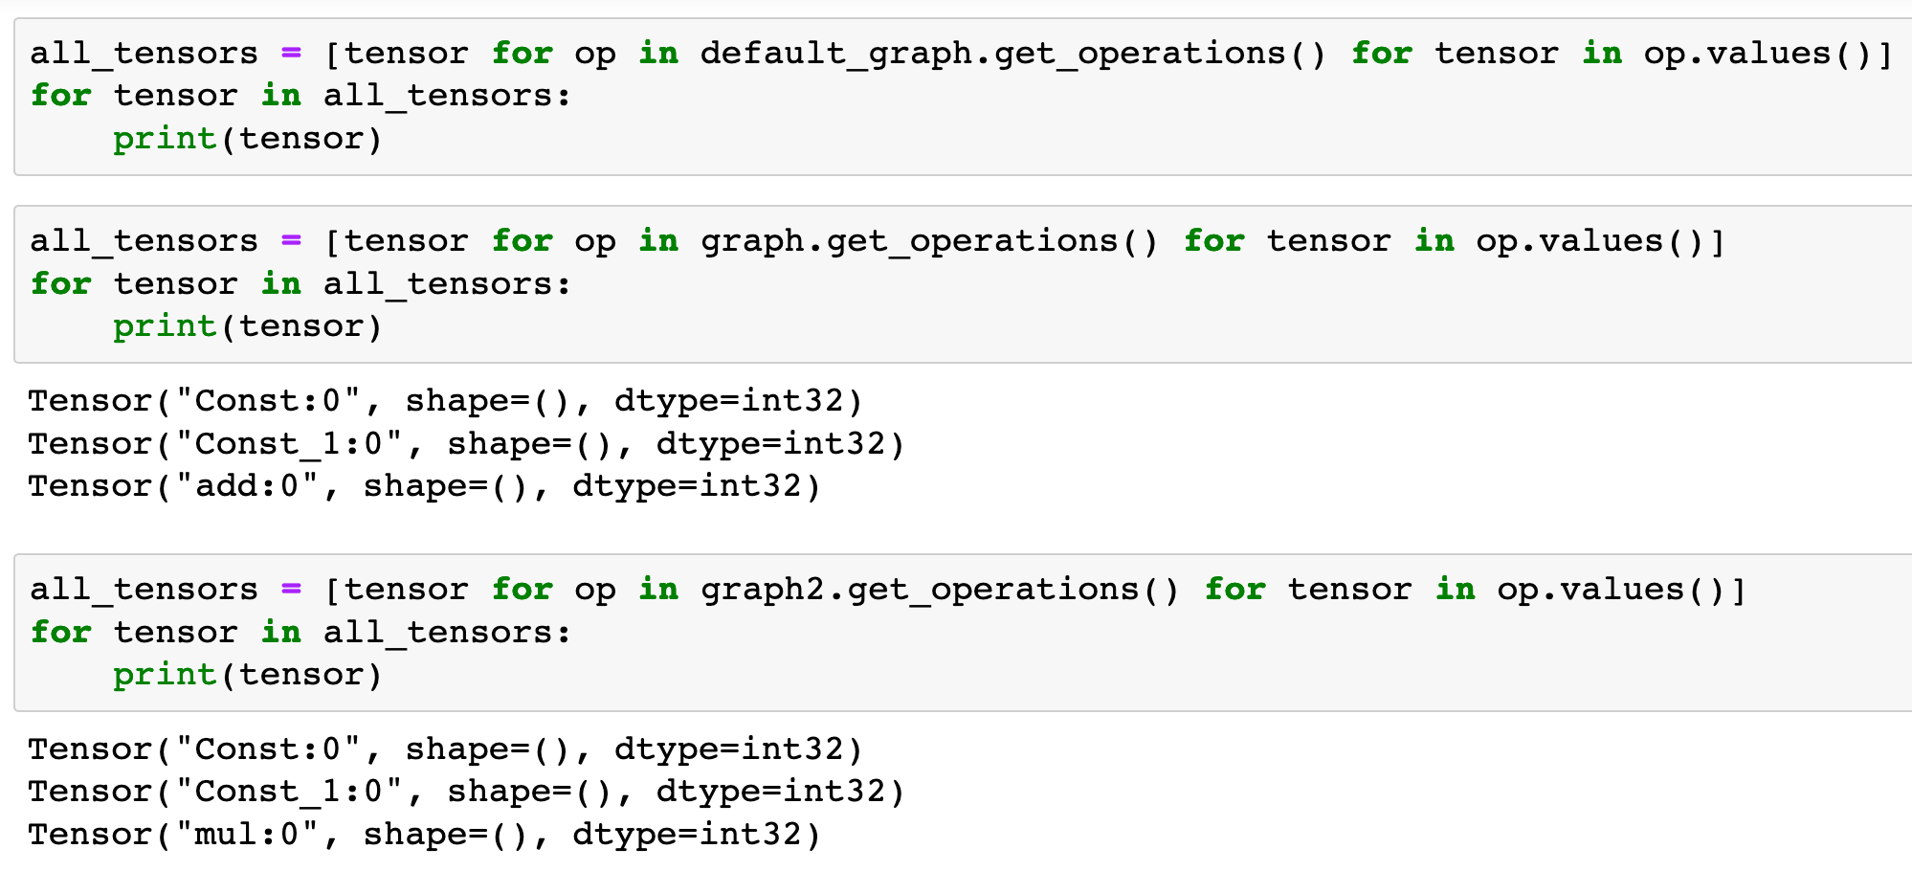

Slide 17
graph.get_tensor_by_name()

Slide 18
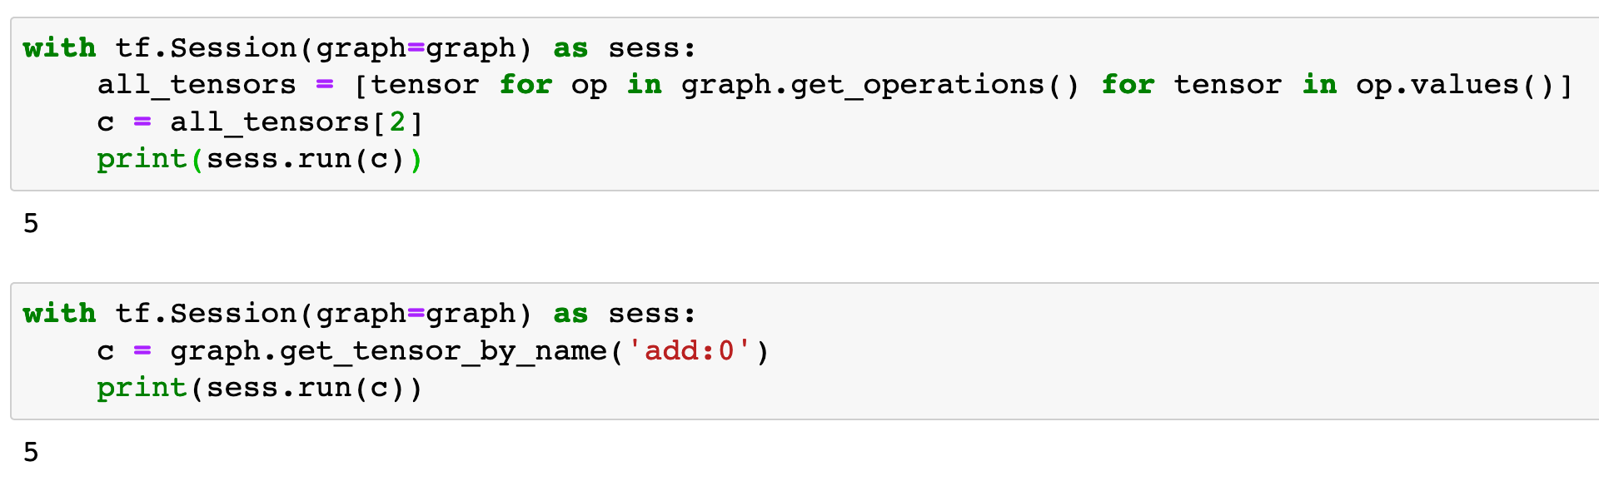

Slide 20
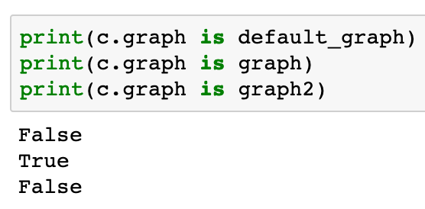

Slide 21
Now
Let’s Play with Code

